Slide 1
Concurrency control
Dr. M. Brindha
Assistant Professor
Department of CSE
NIT, Trichy-15

Slide 2
Lock-Based Protocols
A lock is a mechanism to control concurrent access to a data item
Data items can be locked in two modes :
1. exclusive (X) mode. Data item can be both read as well as
written. X-lock is requested using lock-X instruction.
2. shared (S) mode. Data item can only be read. S-lock is
requested using lock-S instruction.
Lock requests are made to concurrency-control manager. Transaction can proceed only after request is granted.

Slide 3
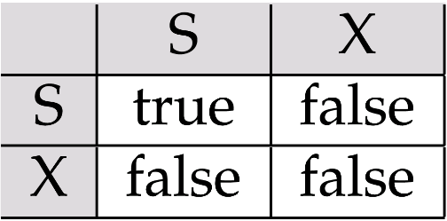
Lock-Based Protocols (Cont.)
Lock-compatibility matrix
A transaction may be granted a lock on an item if the requested lock is compatible with locks already held on the item by other transactions
Any number of transactions can hold shared locks on an item, but if any transaction holds an exclusive on the item no other transaction may hold any lock on the item.
If a lock cannot be granted, the requesting transaction is made to wait till all incompatible locks held by other transactions have been released. The lock is then granted.

Slide 4
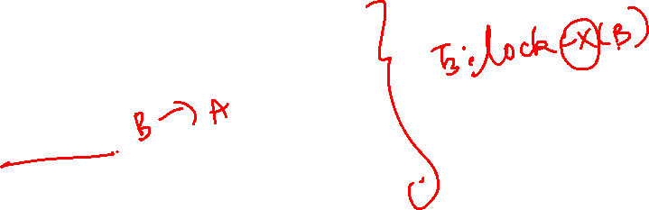
Lock-Based Protocols (Cont.)
Example of a transaction performing locking:
Locking as above is not sufficient to guarantee serializability — if A and B get updated in-between the read of A and B, the displayed sum would be wrong.
A locking protocol is a set of rules followed by all transactions while requesting and releasing locks. Locking protocols restrict the set of possible schedules.
T₃: lock-X(B); read (B); B:=B-50; write(B); unlock(B); lock-X(A); read (A); A:=A+50; write(A) unlock(A); | T₄: lock-S(A); read (A); unlock(A); lock-S(B); read (B); unlock(B); display(A+B)

Slide 5
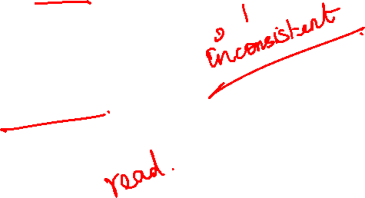
Lock-Based Protocols (Cont.)
Concurrent execution of transactions performing locking:
T₁: lock-X(B); read (B); B:=B-50; write(B); unlock(B); lock-X(A); read (A); A:=A+50; write(A) unlock(A); | T₂: lock-S(A); read (A); unlock(A); lock-S(B); read (B); unlock(B); display(A+B)

Slide 6
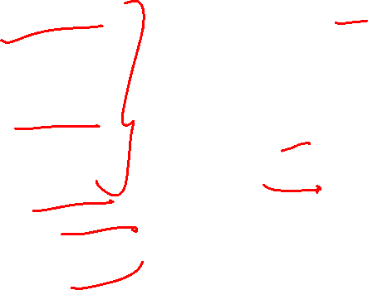
Lock-Based Protocols (Cont.)
Example of a transaction performing locking:
T₃: lock-X(B); read (B); B:=B-50; write(B); lock-X(A); read (A); A:=A+50; write(A); unlock(B); unlock(A); | T4: lock-S(A); read (A); lock-S(B); read (B); display(A+B) unlock(A); unlock(B);

Slide 7
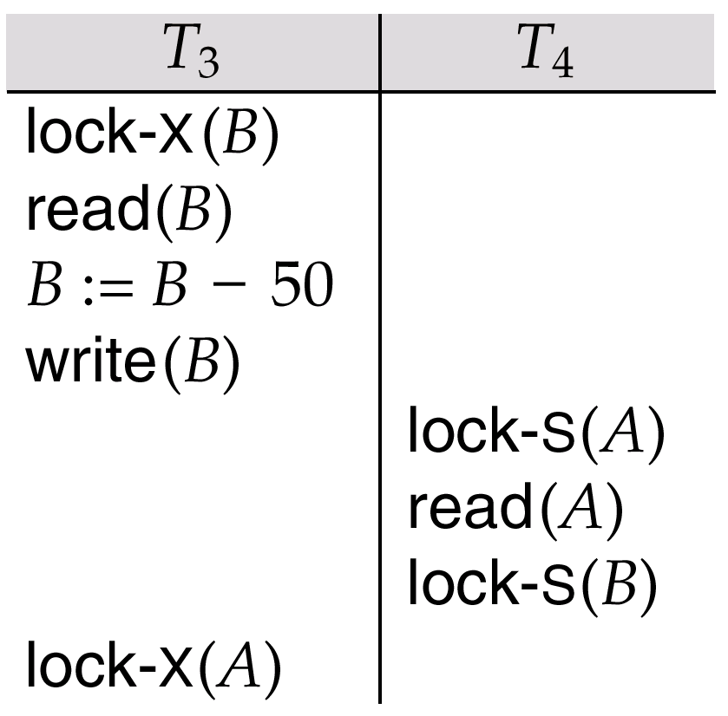
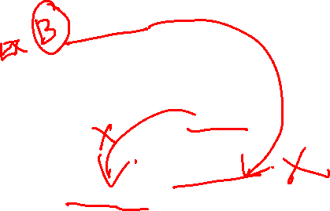
Pitfalls of Lock-Based Protocols
Consider the partial schedule
Neither T₃ nor T₄ can make progress — executing lock-S(B) causes T₄ to wait for T₃ to release its lock on B, while executing lock-X(A) causes T₃ to wait for T₄ to release its lock on A.
Such a situation is called a deadlock.
To handle a deadlock one of T₃ or T₄ must be rolled back and its locks released.

Slide 8
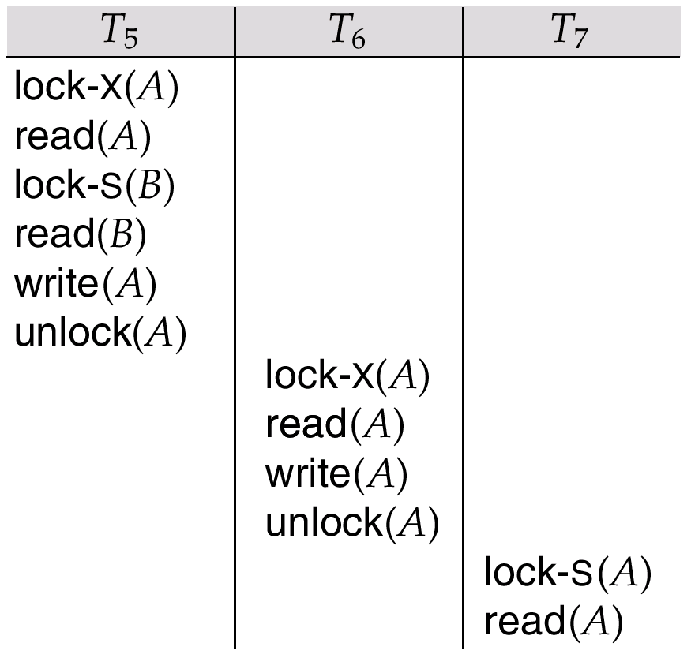
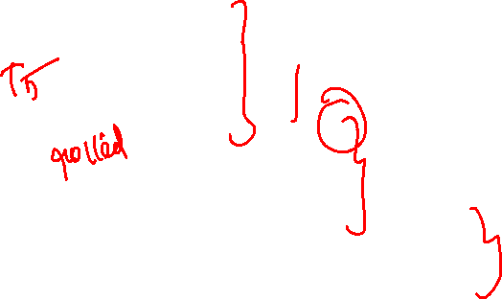
Pitfalls of Lock-Based Protocols
Consider the partial schedule
Cascading rollback

Slide 9
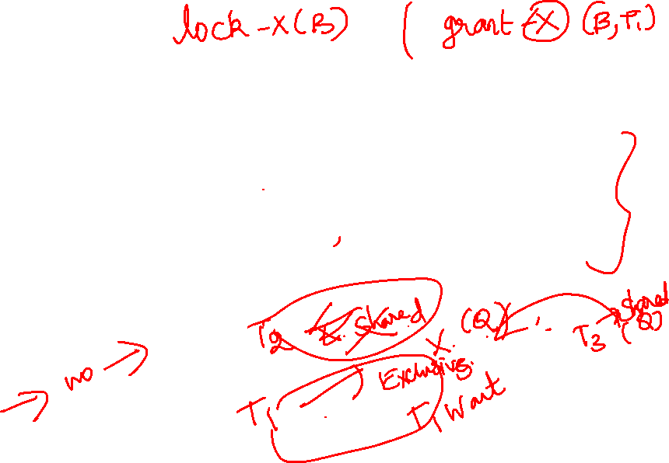
Pitfalls of Lock-Based Protocols (Cont.)
The potential for deadlock exists in most locking protocols. Deadlocks are a necessary evil.
Starvation is also possible if concurrency control manager is badly designed. For example:
A transaction may be waiting for an X-lock on an item, while a sequence of other transactions request and are granted an S-lock on the same item.
The same transaction is repeatedly rolled back due to deadlocks.
Concurrency control manager can be designed to prevent starvation.

Slide 10

The Two-Phase Locking Protocol
This is a protocol which ensures conflict-serializable schedules.
Phase 1: Growing Phase
transaction may obtain locks
transaction may not release locks
Phase 2: Shrinking Phase
transaction may release locks
transaction may not obtain locks
The protocol assures serializability. It can be proved that the transactions can be serialized in the order of their lock points (i.e. the point where a transaction acquired its final lock).

Slide 11
Two phase Locking Protocols
Consider the partial schedule
Neither T₃ nor T₄ can make progress — executing lock-S(B) causes T₄ to wait for T₃ to release its lock on B, while executing lock-X(A) causes T₃ to wait for T₄ to release its lock on A.
Such a situation is called a deadlock.
To handle a deadlock one of T₃ or T₄ must be rolled back and its locks released.
Two-phase locking does not ensure freedom from deadlocks

Slide 12
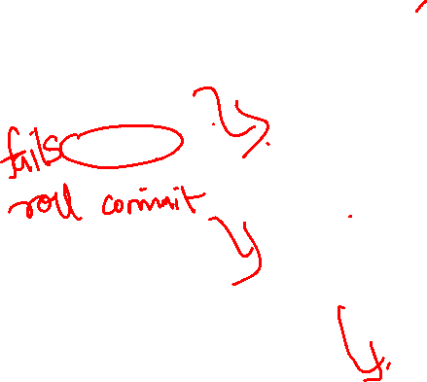
Two Phase locking Protocols (Cont.)
Concurrent execution of transactions-Cascading rollback
T₁: lock-X(A); read (A); lock-S(B); read(B) write(A); unlock(A); | T₂: lock-X(A); read (A); write(A) unlock(A); T3:lock-S(A) read(A)

Slide 13
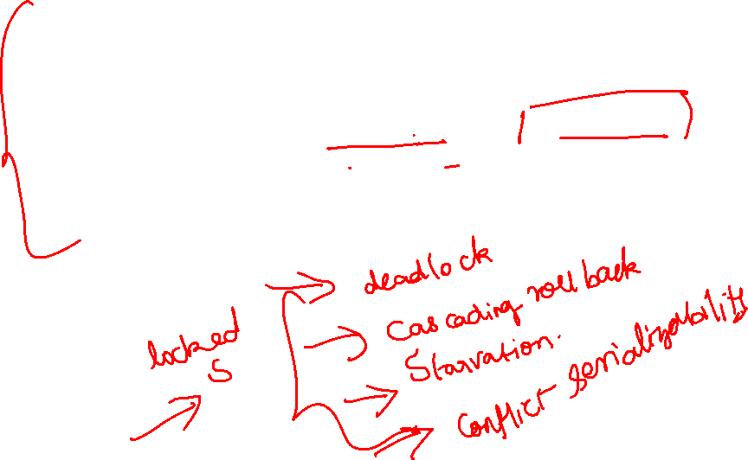
The Two-Phase Locking Protocol (Cont.)
Cascading roll-back is possible under two-phase locking. To avoid this, follow a modified protocol called strict two-phase locking. Here a transaction must hold all its exclusive locks till it commits/aborts.
Rigorous two-phase locking is even stricter: here all locks are held till commit/abort. In this protocol transactions can be serialized in the order in which they commit.

Slide 14
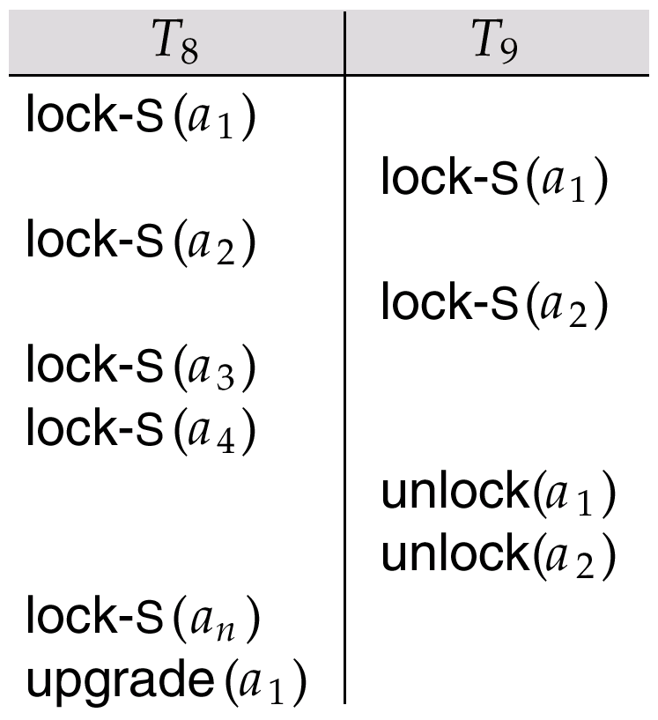
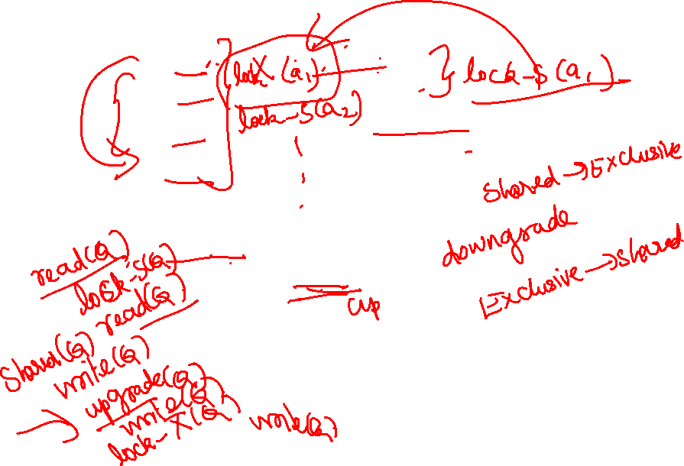
Two Phase locking Protocols (Cont.)
Whether these transactions can be executed concurrently
Now see this
T₁: read(a1); read (a2); ---------- read(a_{n}); write(a1); | T₂: read(a1); read (a2); display(a1+a2);
Upgrade-Shared to Exclusive
Downgrade-Exclusive to shared

Slide 15
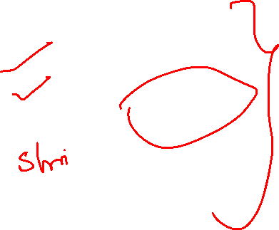
Lock Conversions
Two-phase locking with lock conversions:
– First Phase:
can acquire a lock-S on item
can acquire a lock-X on item
can convert a lock-S to a lock-X (upgrade)
– Second Phase:
can release a lock-S
can release a lock-X
can convert a lock-X to a lock-S (downgrade)
This protocol assures serializability. But still relies on the programmer to insert the various locking instructions.

Slide 16
Two phase locking protocol
If transaction Ti issues read(Q), the system issues lock-S(Q) followed by read(Q).
2. When transaction Ti issues write (Q), checks for Ti already having shared lock on Q.
If it does, issues an upgrade(Q) followed by write(Q)
Otherwise, issues lock-(Q)followed by write (Q)
3. All locks obtained by a transaction are unlocked after the transaction commits or aborts

Slide 17
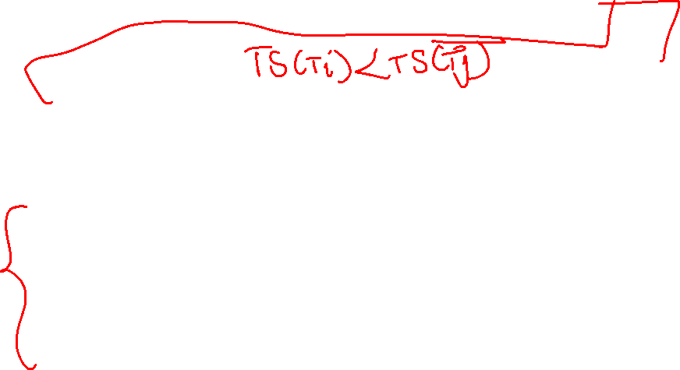
Timestamp-Based Protocols
Each transaction is issued a timestamp when it enters the system. If an old transaction T_{i} has time-stamp TS(T_{i}), a new transaction T_{j} is assigned time-stamp TS(T_{j}) such that TS(T_{i}) <TS(T_{j}).
The protocol manages concurrent execution such that the time-stamps determine the serializability order.
In order to assure such behavior, the protocol maintains for each data Q two timestamp values:
W-timestamp(Q) is the largest time-stamp of any transaction that executed write(Q) successfully.
R-timestamp(Q) is the largest time-stamp of any transaction that executed read(Q) successfully.

Slide 18
Timestamp-Based Protocols (Cont.)
The timestamp ordering protocol ensures that any conflicting read and write operations are executed in timestamp order.
Suppose a transaction T_{i} issues a read(Q)
1. If TS(T_{i}) < W-timestamp(Q), then T_{i} needs to read a value of Q that was already overwritten. Hence, the read operation is rejected, and T_{i} is rolled back.
2. If TS(T_{i})≥ W-timestamp(Q), then the read operation is
executed, and R-timestamp(Q) is set to the maximum of R- timestamp(Q) and TS(T_{i}).

Slide 19
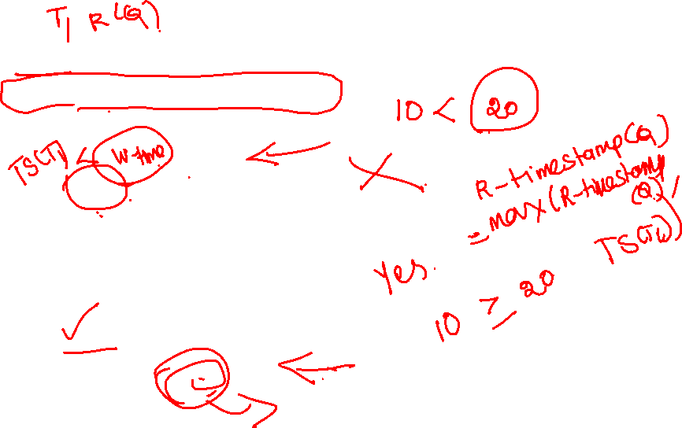
Timestamp-Based Protocols (Cont.)
T_{i} issues a read(Q)
1. If TS(T_{i}) < W-timestamp(Q)
read rejected and T_{i} rolled back
If TS(T_{i})≥ W-timestamp(Q)
Execute Read
R-timestamp(Q) = max(R- timestamp(Q) , TS(T_{i}))
T1(TS=10) | T2(TS=20)
 | W(Q)
R(Q)
T1(TS=10) | T2(TS=20)
W(Q)
 | R(Q)

Slide 20

Timestamp-Based Protocols (Cont.)
Suppose that transaction T_{i} issues write(Q).
If TS(T_{i}) < R-timestamp(Q), then the value of Q that T_{i} is producing was needed previously, and the system assumed that that value would never be produced. Hence, the write operation is rejected, and T_{i} is rolled back.
If TS(T_{i}) < W-timestamp(Q), then T_{i} is attempting to write an obsolete value of Q. Hence, this write operation is rejected, and T_{i} is rolled back.
Otherwise, the write operation is executed, and W-timestamp(Q) is set to TS(T_{i}).

Slide 21
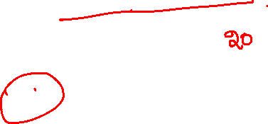
Timestamp-Based Protocols (Cont.)
T_{i} issues a write(Q)
1. If TS(T_{i}) < R-timestamp(Q)
write rejected and T_{i} rolled back
If TS(T_{i})<W-timestamp(Q)
write rejected and T_{i} rolled back
T1(TS=10) | T2(TS=20)
 | R(Q)
W(Q)
T1(TS=10) | T2(TS=20)
 | W(Q)
W(Q)

Slide 22
Timestamp-Based Protocols (Cont.)
T_{i} issues a write(Q)
1. If TS(T_{i}) ≥ R-timestamp(Q)
Execute write
If TS(T_{i})≥ W-timestamp(Q)
Execute write
W-timestamp(Q) = TS(T_{i})
T1(TS=10) | T2(TS=20)
R(Q)
 | W(Q)
T1(TS=10) | T2(TS=20)
W(Q)
 | W(Q)

Slide 23
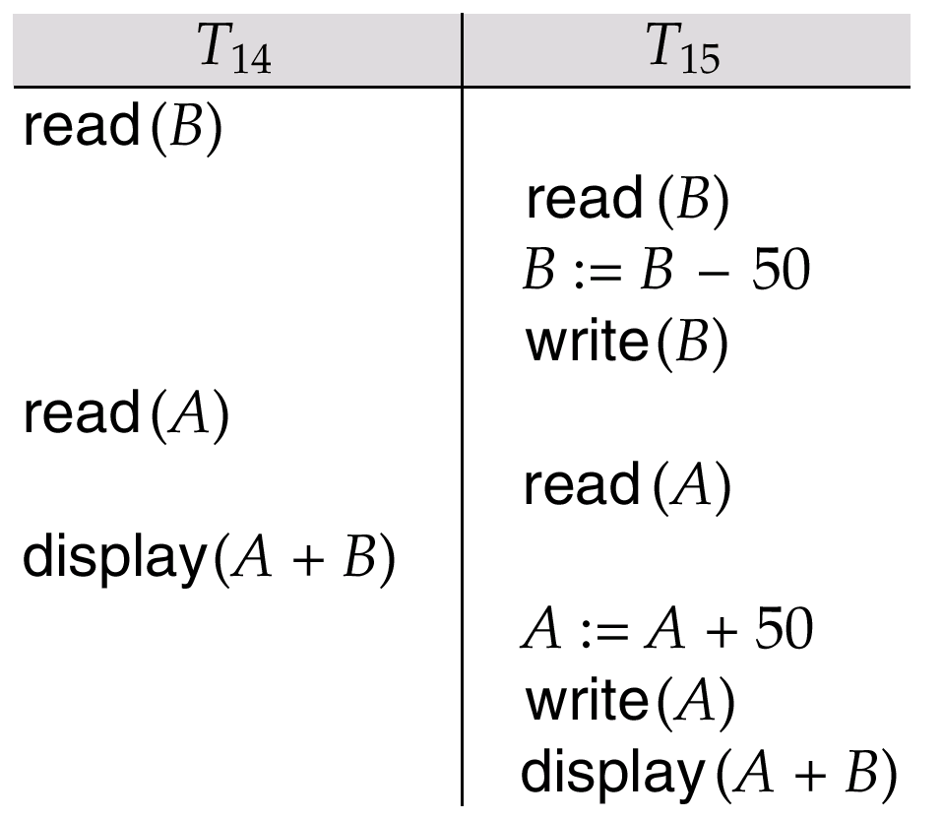
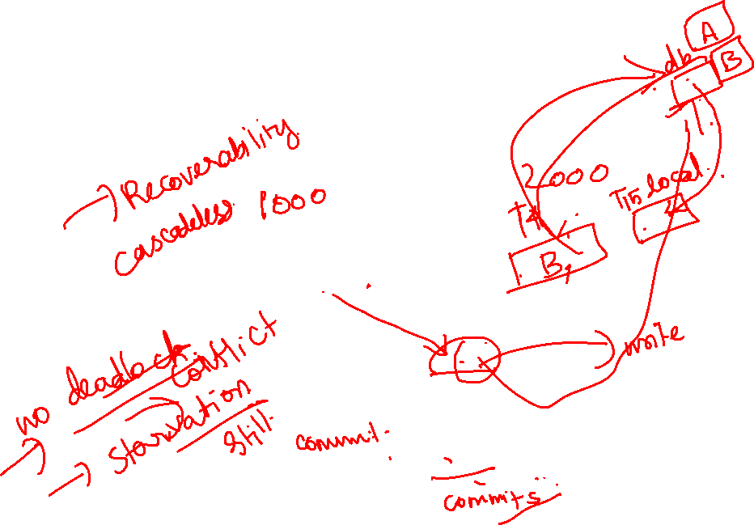
Time stamp-Based Protocols (Cont.)
Example of a transaction performing locking:
Check this schedule
T1: read (B); read (A); display(A+B) | T₂: read (B); B:=B-50; write(B); read (A); A:=A+50; write(A); display(A+B)

Slide 24
Correctness of Timestamp-Ordering Protocol
The timestamp-ordering protocol guarantees serializability since all the arcs in the precedence graph are of the form:
Thus, there will be no cycles in the precedence graph
Timestamp protocol ensures freedom from deadlock as no transaction ever waits.
But the schedule may not be cascade-free, and may not even be recoverable.
It may cause starvation, if long transactions are restarted repeatedly due to conflicting short transaction
transaction
with smaller
timestamp
transaction
with larger
timestamp

Slide 25
Recoverability and Cascade Freedom
Problem with timestamp-ordering protocol:
Suppose T_{i} aborts, but T_{j} has read a data item written by T_{i}
Then T_{j} must abort; if T_{j} had been allowed to commit earlier, the schedule is not recoverable.
Further, any transaction that has read a data item written by T_{j} must abort
This can lead to cascading rollback --- that is, a chain of rollbacks
Solution:
A transaction is structured such that its writes are all performed at the end of its processing
All writes of a transaction form an atomic action; no transaction may execute while a transaction is being written
Reads of uncommitted items are postponed until the transaction that updated the item commits.
A transaction that aborts is restarted with a new timestamp

Slide 26
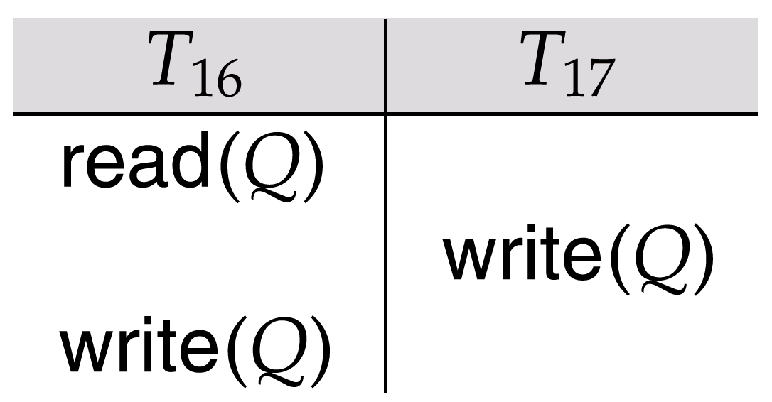
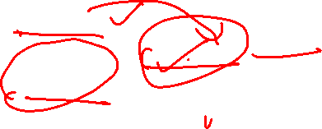
Time stamp ordering
Check for this schedule
T16 is attempting to write is one that will never be read

Slide 27

Thomas’ Write Rule
Modified version of the timestamp-ordering protocol in which obsolete write operations may be ignored under certain circumstances.
When T_{i} attempts to write data item Q, if TS(T_{i}) < W-timestamp(Q), then T_{i} is attempting to write an obsolete value of {Q}. Hence, rather than rolling back T_{i} as the timestamp ordering protocol would have done, this {write} operation can be ignored.
Otherwise this protocol is the same as the timestamp ordering protocol.
Thomas' Write Rule allows greater potential concurrency.

Slide 28
Thomas write rule
Suppose that transaction T_{i} issues write(Q).
If TS(T_{i}) < R-timestamp(Q), then the value of Q that T_{i} is producing was needed previously, and the system assumed that that value would never be produced. Hence, the write operation is rejected, and T_{i} is rolled back.
If TS(T_{i}) < W-timestamp(Q), then T_{i} is attempting to write an obsolete value of Q. Hence, this write operation is ignored, rather than T_{i} is rolled back.
Otherwise, the write operation is executed, and W-timestamp(Q) is set to TS(T_{i}).

Slide 29

Deadlock Handling
Consider the following two transactions:
T₁: write (X) T₂: write(Y)
write(Y) write(X)
Schedule with deadlock
T₁
T₂
lock-X on X
write (X)
lock-X on Y
write (X)
wait for lock-X on X
wait for lock-X on Y
Dead lock prevention, Deadlock detection and recovery

Slide 30
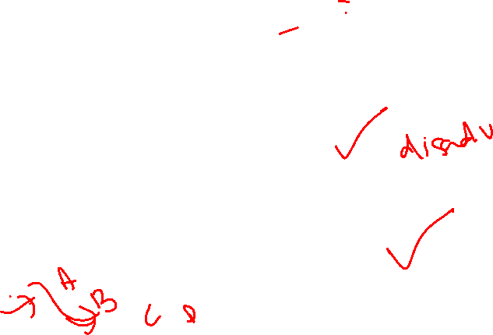
Deadlock Handling
System is deadlocked if there is a set of transactions such that every transaction in the set is waiting for another transaction in the set.
Deadlock prevention protocols ensure that the system will never enter into a deadlock state. Some prevention strategies :
Require that each transaction locks all its data items before it begins execution (predeclaration).
Impose partial ordering of all data items and require that a transaction can lock data items only in the order specified by the partial order (graph-based protocol).

Slide 31
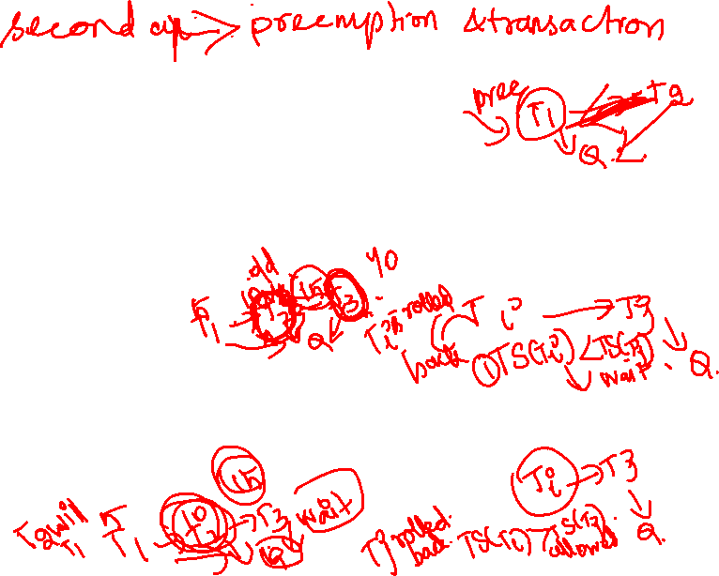
More Deadlock Prevention Strategies
Following schemes use transaction timestamps for the sake of deadlock prevention alone.
wait-die scheme — non-preemptive
older transaction may wait for younger one to release data item. Younger transactions never wait for older ones; they are rolled back instead.
a transaction may die several times before acquiring needed data item
wound-wait scheme — preemptive
older transaction wounds (forces rollback) of younger transaction instead of waiting for it. Younger transactions may wait for older ones.
may be fewer rollbacks than wait-die scheme.

Slide 32
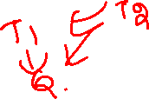
Deadlock prevention (Cont.)
Both in wait-die and in wound-wait schemes, a rolled back transactions is restarted with its original timestamp. Older transactions thus have precedence over newer ones, and starvation is hence avoided.
Timeout-Based Schemes :
a transaction waits for a lock only for a specified amount of time. After that, the wait times out and the transaction is rolled back.
thus deadlocks are not possible
simple to implement; but starvation is possible. Also difficult to determine good value of the timeout interval.

Slide 33
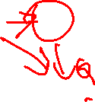
Deadlock Detection
Deadlocks can be described as a wait-for graph, which consists of a pair G = (V,E),
V is a set of vertices (all the transactions in the system)
E is a set of edges; each element is an ordered pair T_{i} →T_{j}.
If T_{i} → T_{j} is in E, then there is a directed edge from T_{i} to T_{j}, implying that T_{i} is waiting for T_{j} to release a data item.
When T_{i} requests a data item currently being held by T_{j}, then the edge T_{i} T_{j} is inserted in the wait-for graph. This edge is removed only when T_{j} is no longer holding a data item needed by T_{i}.
The system is in a deadlock state if and only if the wait-for graph has a cycle. Must invoke a deadlock-detection algorithm periodically to look for cycles.

Slide 34
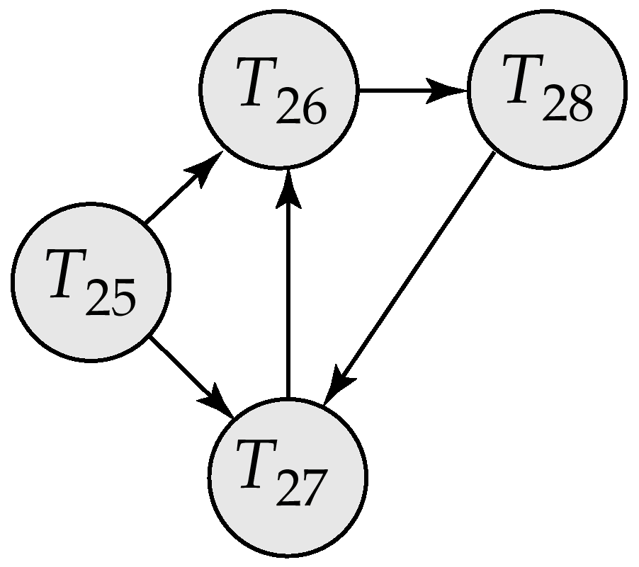
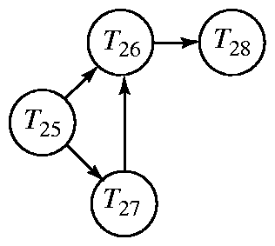
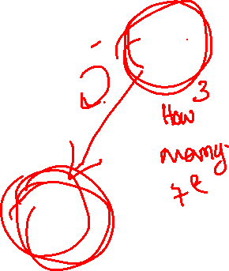
Deadlock Detection (Cont.)
Wait-for graph without a cycle
Wait-for graph with a cycle

Slide 35
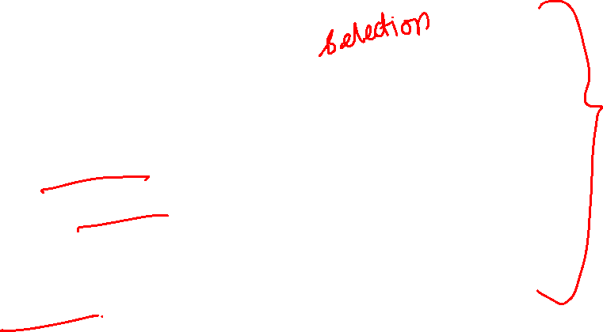
Deadlock Recovery
When deadlock is detected :
Some transaction will have to rolled back (made a victim) to break deadlock. Select that transaction as victim that will incur minimum cost.
Rollback -- determine how far to roll back transaction
Total rollback: Abort the transaction and then restart it.
More effective to roll back transaction only as far as necessary to break deadlock.
Starvation happens if same transaction is always chosen as victim. Include the number of rollbacks in the cost factor to avoid starvation

Slide 36

Thank You!!!

